Slide 1








Creative Showcase
EDUCATIONAL TALK
Academic Perspectives on
Emerging Challenges and Solutions

Slide 2


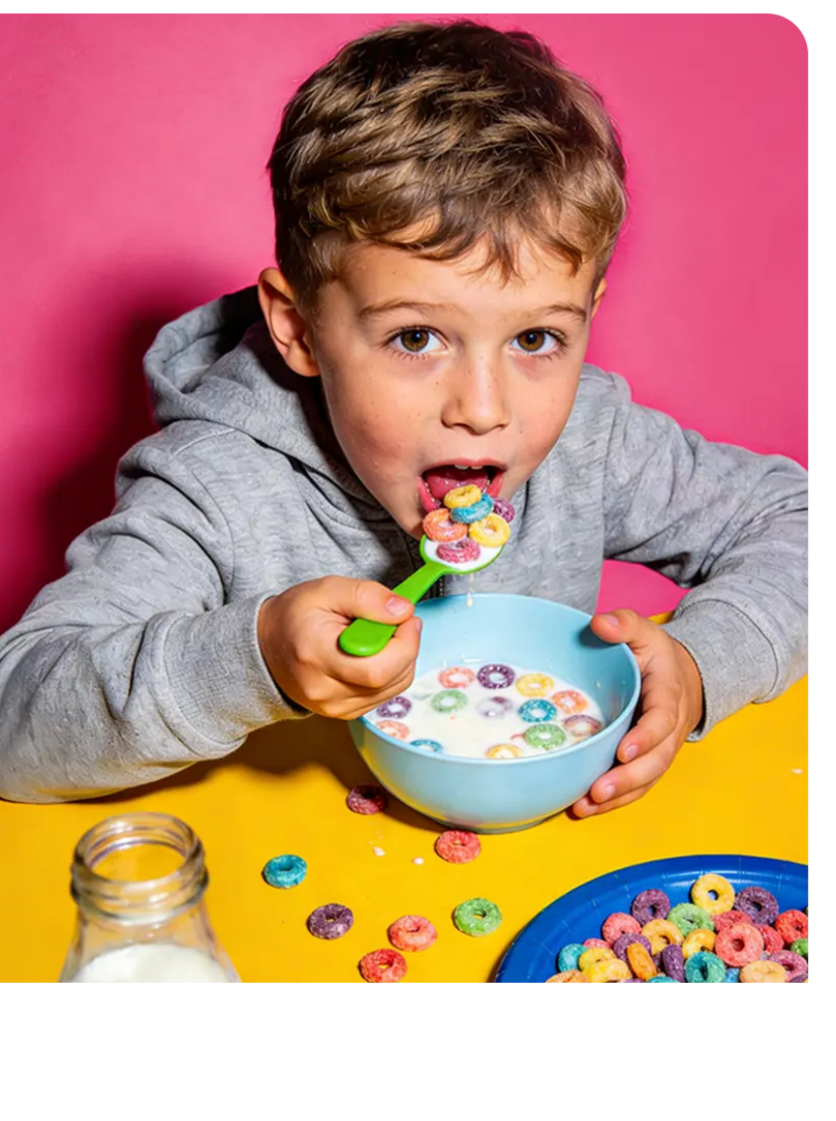


LET EDUCATION MOVE FORWARD WITH WARMTH
Good education is never an order of “what you should do”, but companionship of “let‘s try together”: when a child knocks over paint, instead of first blaming them for wasting it, you draw a rainbow with the spilled paint together with them, allowing them to learn from the mistake that errors can also turn into new possibilities.
Good education is never an order of “what you should do”, but companionship of “let‘s try together”: when a child knocks over paint, instead of first blaming them for wasting it, you draw a rainbow with the spilled paint together with them, allowing them to learn from the mistake that errors can also turn into new

Slide 3

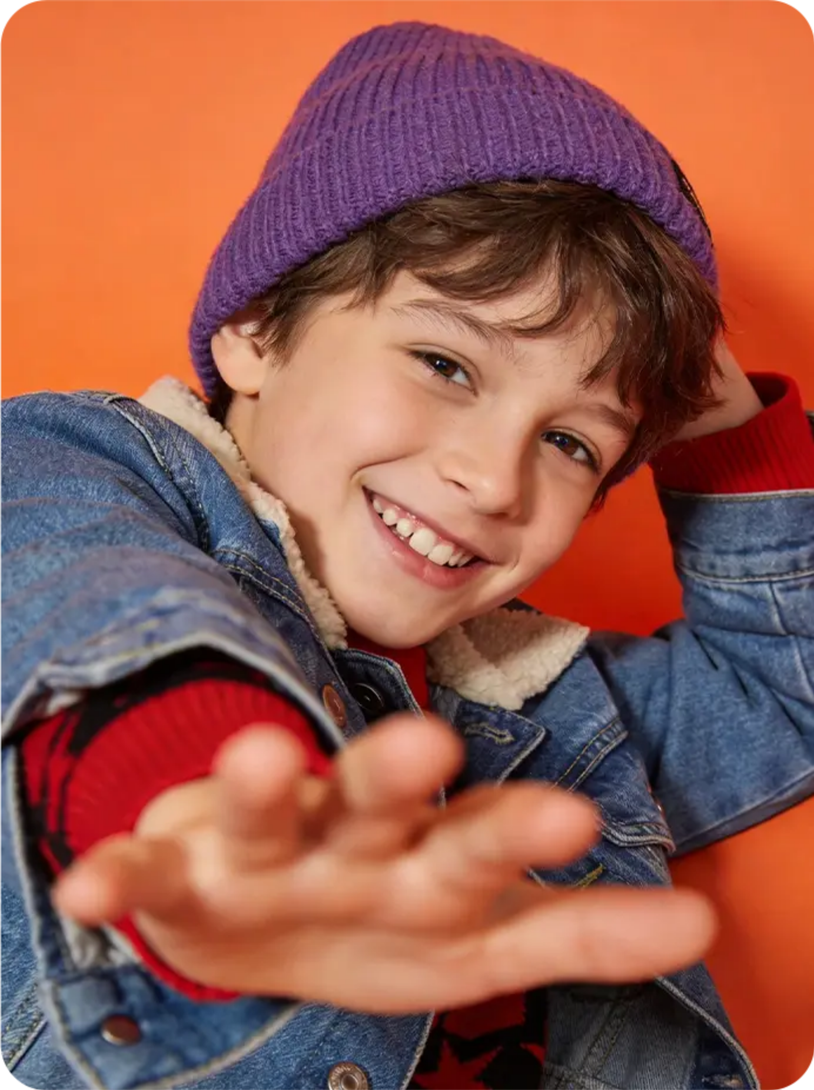




Core Educational Philosophy:
A SHARING SESSION
It is no longer “what teachers teach, students learn”, but observing students‘ interests and pain points, and designing learning content that fits them. For example, if a child likes painting, use painting to teach mathematics (recognizing shapes, calculating proportions), turning learning from “passive.
Don't rush to judge right or wrong, first defuse emotions — squat down to pick up colored paper with the children, and divert their attention by saying "Does this yellow paper look like a winter jasmine flower?" to ease the tense atmosphere.

Slide 4












What Are We Talking About?
never
together
gradually
Answer a few
short questions.
It takes less than 3 minutes.
Be honest!
There are no right or wrong answers.

Slide 5











CASE INSPIRATION
Highlight the text you want to hyperlink, select the link symbol,
then select from the dropdown the page that you want to connect.
Why do a poll
Classroom poll
How it works
Next steps

Slide 6












CASE INSPIRATION
01
02
03
Classroom poll
Next
steps
Young
spling
Education is like nurturing a young sapling: there’ s no need to rush to straighten
it or prune all saplings into identical shapes. Instead, we should give it ample
sunlight and patience.

Slide 7




Why Do We Need to
Rethink About Education?
• Education is like nurturing a young sapling

Slide 8

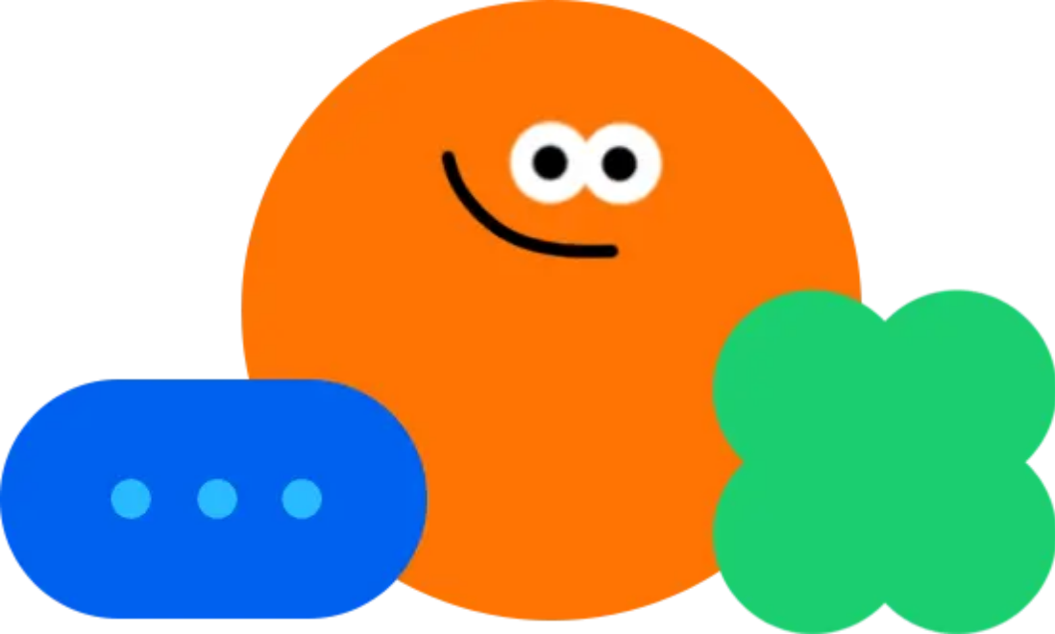





When We Talk About Education, What Are We Talking About?
Talk About Education
you should do", but companionship of "let's try together": when a child knocks over paint, instead of first blaming them for wasting it, you draw a rainbow with the spilled paint together with them, allowing them to learn from the mistake that errors can also turn into new possibilities.

Slide 9










Focus on Complete Growth
Why do a poll
Classroom poll
•Tip: Use links to go to a different page inside your presentation.
Use links to go to a different page inside yourpresentation. Highlight the text you want to hyperlink, select the linksymbol, then select from the dropdown the page that you want toconnect.
Use links to go to a different page inside yourpresentation. Highlight the text you want to hyperlink, select the linksymbol, then select from the dropdown the page that you want toconnect.
Use links to go to a different page inside yourpresentation. Highlight the text you want to hyperlink, select the linksymbol, then select from the dropdown the page that you want toconnect.
How it works
Next
steps

Slide 10




When We Talk About
Education, What Are We Talking About?

Slide 11












CASE INSPIRATION
Classroom poll
Quick
Quick
It takes less than 3 minutes.
It takes less than 3 minutes.
Next steps
companionship of "let's try together": when a child knocks over paint, instead of first blaming them for wasting it, you draw a rainbow with the spilled paint together with them, allowing them to learn from the mistake that errors can also turn into new possibilities.
Young sapling

Slide 12


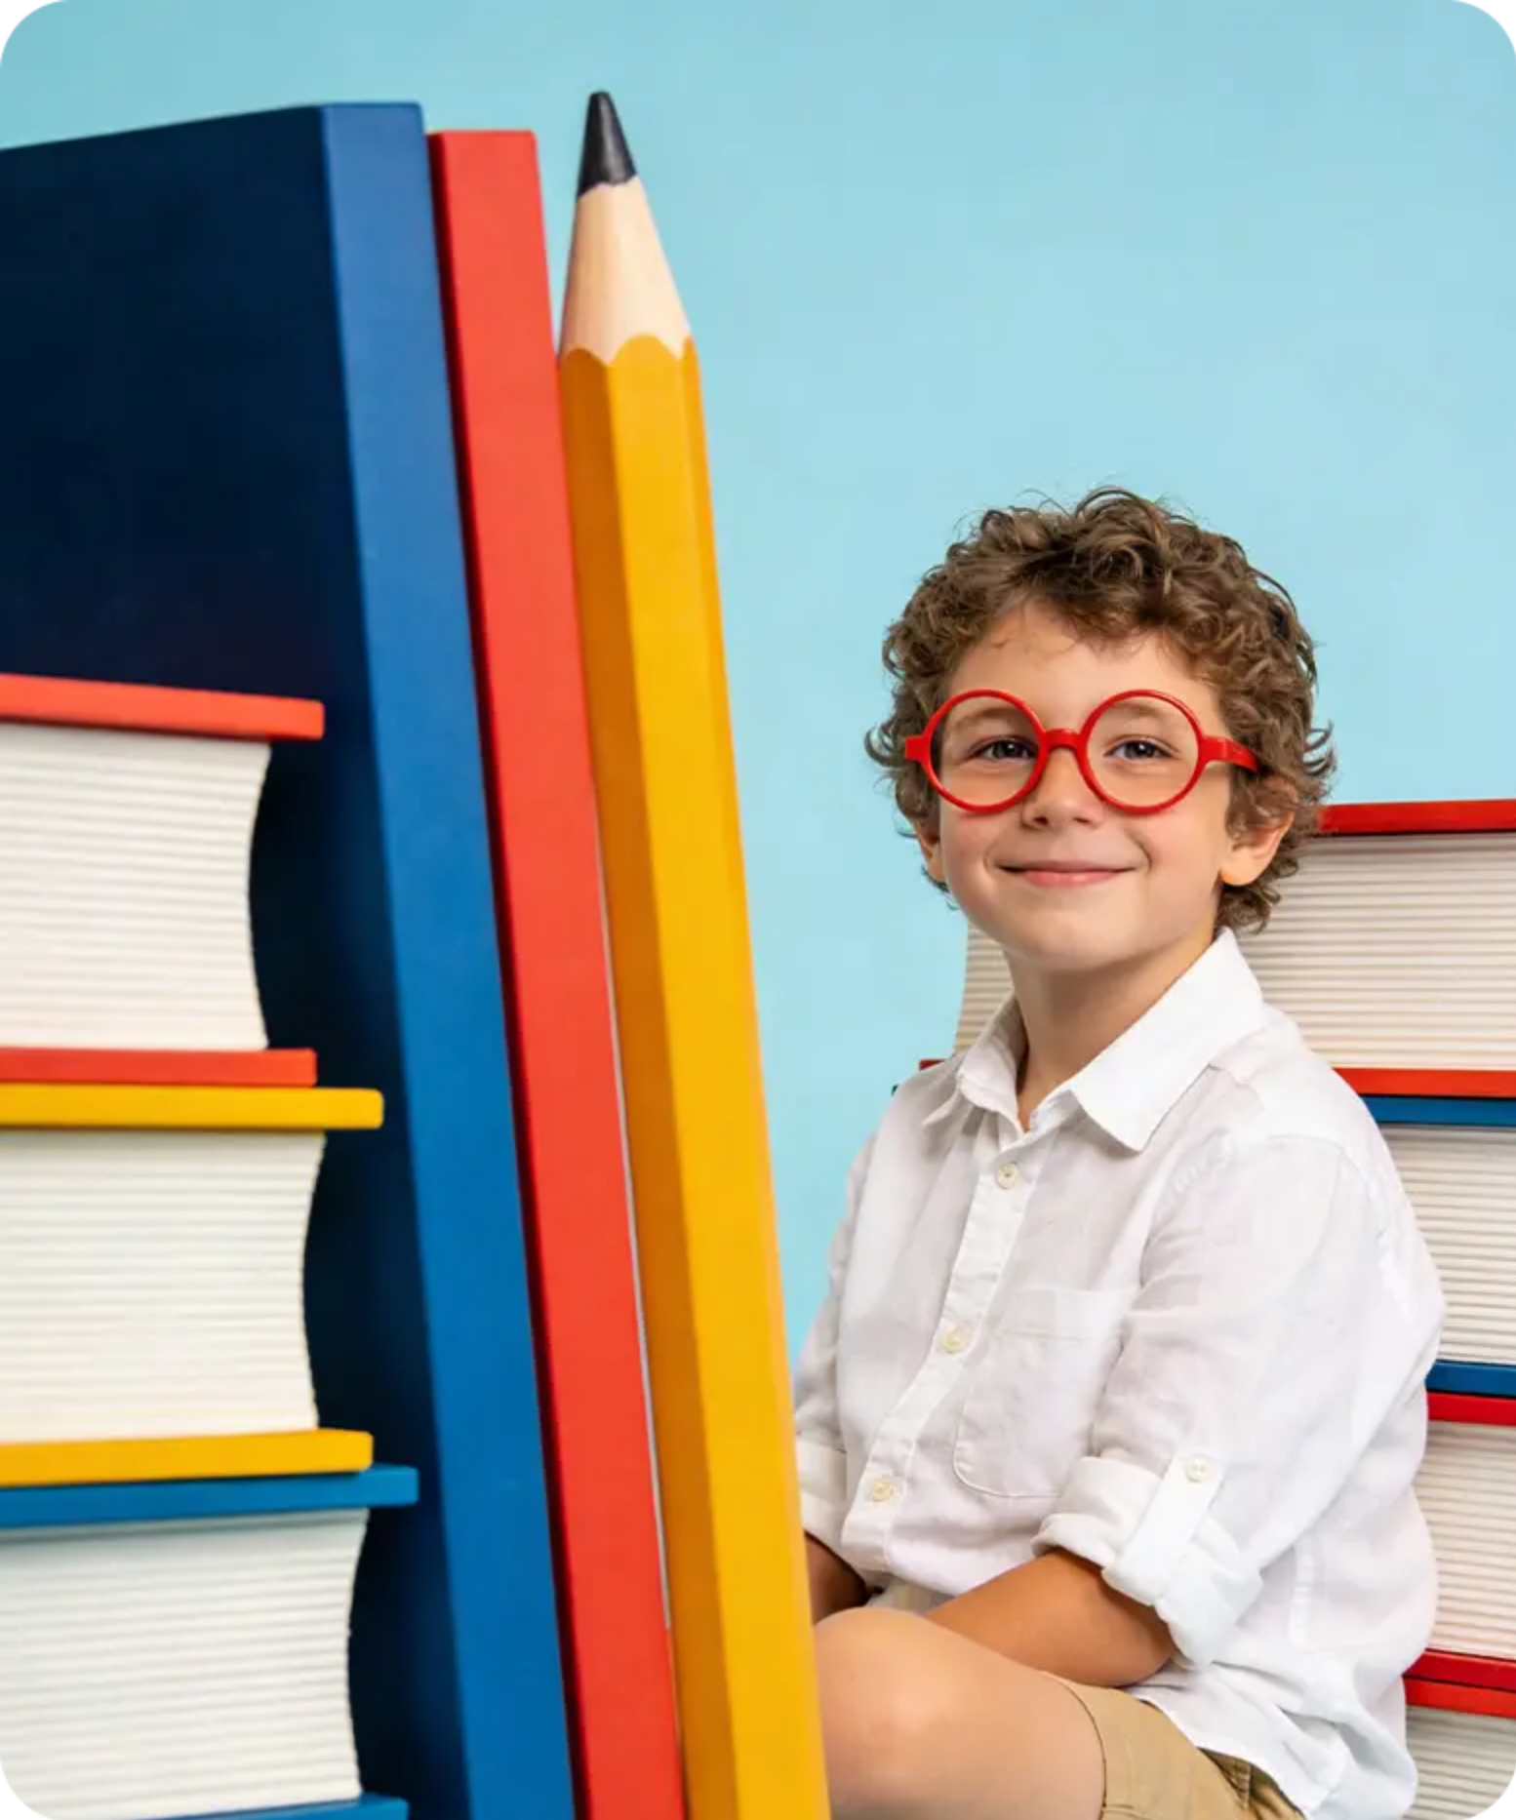


Holistic Education Focus on “Complete Growth”
Good education is never an order of "what you should do", but companionship of "let's try together": when a child knocks over paint, instead of first blaming them for wasting it, you draw a rainbow with the spilled paint together with them, allowing them to learn from the mistake that errors can also turn into new possibilities.

Slide 13




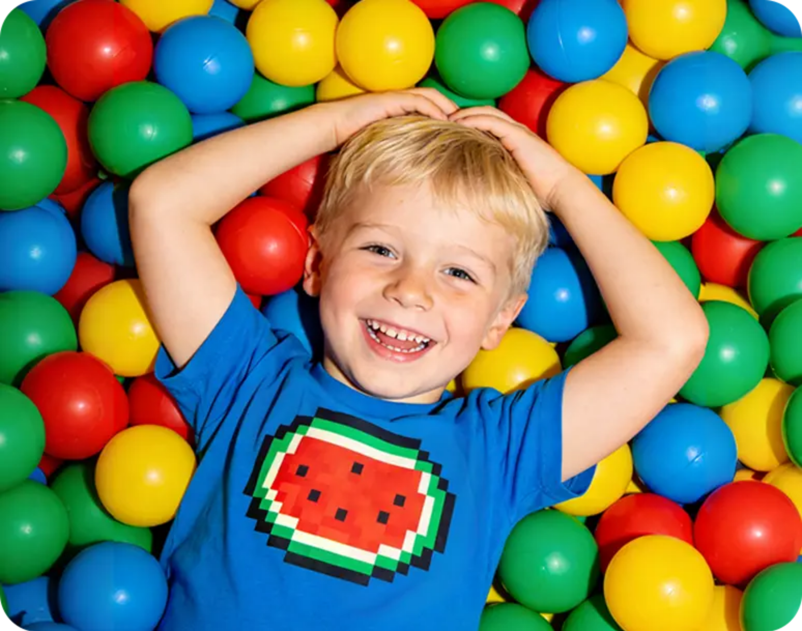



Personalized Support Plan:
Use “Strengths” to Drive “Weaknesses”
JUDGEMENT
DON'T RUSH TO JUDGE RIGHT OR WRONG
DON'T RUSH TO JUDGE RIGHT OR WRONG
DON'T RUSH TO JUDGE RIGHT OR WRONG

Slide 14










Why Do We Need to Rethink Education?
Education is like nurturing a young sapling
Simple
Quick
Anonymous
Answer a few short questions.
Be honest!
There are no right or wrong answers.
It takes less than 3 minutes.

Slide 15






Next steps
Education
Thanks for Sharig your thoughts
We’ ll review the results together.
Your feedback will guide our next lessons and activities.

